Slide 1
Attention and Consciousness
PSY 101, BRAC University
Notes:
I want to convince you that in addition to slips of attention that can occur as you get
older, also how you attend to the world around you is weirder than you think. In a
broad sense, I hope to convince you that it's happening all the time. Right now, as
you go back to your room, as you walk to the next class, or your room. How you
attend to what's around you in the world is weirder than you think.

Slide 2
What is attention?
Everyone knows what attention is. It is the taking possession by the mind in clear and vivid form of one out of what seem several simultaneous objects or trains of thought…It implies withdrawal from some things in order to deal with others.”
- William James, 1890
Notes:
So what is attention? What do we mean by attending to things? So William James
was a psychologist at Harvard who, in many ways, articulated concepts in
psychology that, till this day, turned out to be beautiful ways to talk about them in an
everyday sense.
"Everybody knows what attention is. It's the taking possession by the mind in clear
and vivid form of one out of what seems like several simultaneous objects or trains
of thought. It applies withdrawal of some things in order to deal with others."

Slide 3
Attention
Awareness/consciousness
We often attend to more than we realize
We often attend to less than we realize
Notes:
So a big idea there is we can pay attention to some things and there's a lot of things
around us. And so we have to pick where we focus our attention. A little bit like if
you have a budget. If you have some money, what do you spend your money on,
and what do not spend your money on?

Slide 4
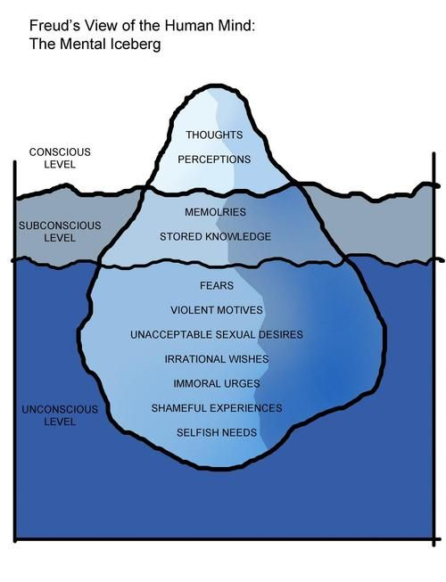

Slide 5
Attention and Consciousness
Attention as gatekeeper to perception and knowledge
Attention is very limited -one thing at a time (we miss a lot)
Unconscious/Unattended processes
(do things we not notice influence us?)
Some external stimuli “capture” our attention -“bottom-up” processing
Some internal thoughts & goals direct our attention -“top-down” processing
Notes:
Attention is very limited. We can only process one thing at a time. And because of
that, we miss a lot around us all the time.
There are unconscious processes that pick up information. So sometimes things
that we don't notice do influence us.
And attention can be viewed as kind of a dialogue between two things. Between
things in the world that capture your attention. If somebody throws a ball at you,
something dramatic happens-- you hear a scary sound that captures your attention-
- we talk about that as "bottom-up" processing. It impinges on you. It forces you to
attend to it. Because it's danger, it's moving, it's unusual.
And then, "top-down" things. What's your goal? What are you paying attention to?
What do you care about? What are you up to? People call that top-down
processing. So things that the environment drives into your attention because
they're so dramatic, bottom-up. Things that you're looking for, thinking about, you
know are useful for your purposes, top-down.

Slide 6
A common object.
10 tk note.
Notes:
HERE ASK THE CLASS TO TRY TO DRAW FROM MEMORY WHAT IS ON A 10 TK NOTE. DESPITE REPEATED EXPOSURE
NOBODY WILL REALLY BE ABLE TO DO THIS. BECAUSE THE HAVE NEVER ATTENDED TO THE DETAILS.
we don't attend to something very specifically, we can see it a
tremendous number of times and it leaves no impression on our mind and no
memory of it. Now, why is that in an everyday sense? We don't know on a deep
3
science sense. But what do you think the point of it is?
BECAUSE IT’S NOT IMPORTANT. So what you attend to, what you decide is important,
makes incredible difference.

Slide 7
Shadowing and Attention (Cherry, 1953)
left ear ‐shadowed message
right ear ‐second message
What could be heard in unattended ear?
if a voice is present
voice changes from man to woman
voice becomes a tone
What was not heard in unattended ear?
•content of message
•language of message
•change in language of message
•speech vs. nonsense backward speech
Notes:
FAMOUS EXPERIMENTS WHERE TO STUDY ATTENTION RESEARCHERS PLAY MESSAGES IN BOTH EARS AND ASK PARTICIPANTS TO ONLY PAY ATTENTION TO ONE EAR. THE EAS THEY DO NOT PAY ATTENTION TO GATHERS SOME INFORMATION BUT NOT EVERYTHING!!!

Slide 8
Conversations at a party:
How can we notice something we do not pay attention to?
Notes:
Have you ever been talking with people, you're at a party. You're at some events, or
something like that. And somebody mentions your name. Especially your first name,
4
but your name. Maybe your last name works, too. And then all of a sudden, you
notice a conversation around you. It's almost hard to pay attention to the person
you're talking to because the person over there has just said your name and you
wonder what they're saying about you.
Now, here's a really interesting paradox. How did you not notice that other
conversation, which you didn't? That's like the shadowing task. I'm talking to one
person, there's some hubbub over here. I don't know what they're talking about. All
a sudden, they say my name and I notice what they're talking about. Well, how did
that happen? I wasn't paying attention to it. I don't know anything about it. But my
name pounced out in my mind and drew my attention to it. So it's kind of a paradox.
I'm not paying attention, but somehow I pick up my name

Slide 9
How can we notice something we do not attend to?
some kinds of information are processed automatically/without attention

Slide 10
Attention
•controlled or top-down
conscious, effortful, selective, focused
goal driven
demands a lot of attention
•automatic or bottom-up
unconscious, easy
stimulus-driven
demands little or no attention

Slide 11
Limits of Attention
Attention is a very constrained resource.

Slide 12
Limits of attention
https://www.youtube.com/watch?v=_bnnmWYI0lM

Slide 13
So what about when we’re REALLY not paying attention?

Slide 14
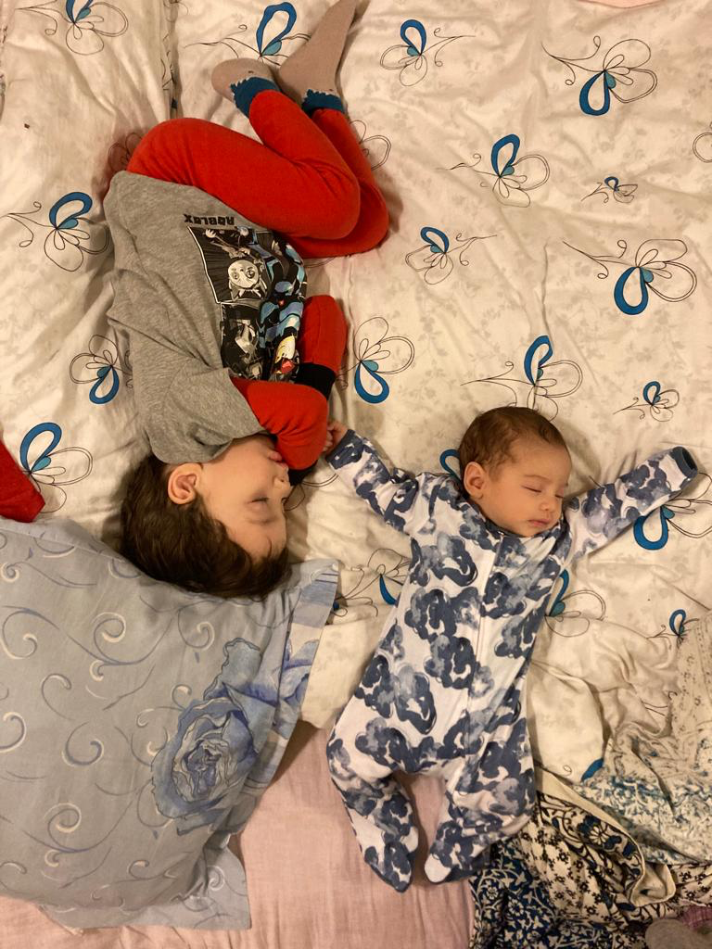
Sleep more, sleep more, sleep more!

Slide 15

Circadian Rhythm
One biological rhythm is the 24-hour circadian rhythm (often known as the ‘body clock’), which is reset by levels of light.
Circadian rhythms are the cycles that tell the body when to sleep, wake, and eat—the biological and psychological processes that oscillate in predictable patterns each day.
This internal clock is influenced by external cues, like sunlight and temperature, which help determine whether one feels energized or exhausted at different times of the day.

Slide 16
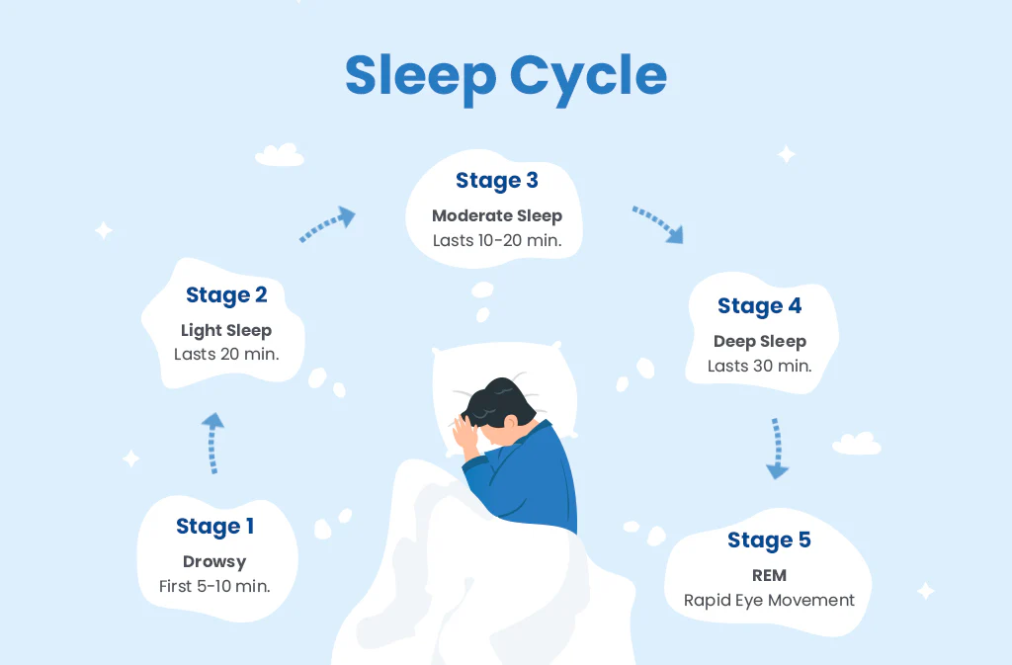

Slide 17
The stages of sleep can be split into two broad categories
NREM sleep: also known as non-rapid eye movement, the NREM stages of sleep are also called ‘quiet sleep’, and is known for holding a majority of the stages of sleep within it (stages 1-4).
REM sleep: Rapid Eye Movement sleep, the REM stages of sleep are where you can expect to experience dreaming as well as deep sleep, which is why it is sometimes known as ‘active sleep’.

Slide 18
Stage 1-Wakefulness
Stage 1 is essentially when a person first falls asleep. This stage normally lasts just one to seven minutes.
During S1 sleep, the body has not fully relaxed, though the body and brain activities start to slow with periods of brief movements. There are light changes in brain activity associated with falling asleep in this stage.
It is easy to wake someone up during this sleep stage, but if a person is not disturbed, they can move quickly into stage 2. As the night unfolds, an uninterrupted sleeper may not spend much more time in stage 1 as they move through further sleep cycles.

Slide 19
Stage 2- Light Sleep
During stage 2 the body enters a more subdued state including a drop in temperature, relaxed muscles, and slowed breathing and heart rate. At the same time, brain waves show a new pattern and eye movement stops. On the whole, brain activity slows, but there are short bursts of activity that actually help resist being woken up by external stimuli.
Stage 2 sleep can last for 10 to 25 minutes during the first sleep cycle, and this stage can become longer during the night. Collectively, a person typically spends about half their sleep time in S2 sleep.

Slide 20
Stage 3 & Stage 4 - Deep Sleep
Stage 3 sleep is deep sleep, and it is harder to wake someone up if they are in this phase. Muscle tone, pulse, and breathing rate decrease as the body relaxes even further.
The brain activity during this period has an identifiable pattern of what are known as delta waves. For this reason, stage 3 may also be called delta sleep or slow-wave sleep (SWS).
Experts believe that this stage is critical to restorative sleep, allowing for bodily recovery and growth. It may also bolster the immune system and other key bodily processes. Even though brain activity is reduced, there is evidence that deep sleep contributes to insightful thinking You spend the most time in deep sleep during the first half of the night. During the early sleep cycles, S3 stages commonly last for 20 to 40 minutes.

Slide 21
REM sleep stage
Once you’re done with the NREM stages of sleep, it’s time to move on to REM. The Rapid Eye Movement stage comes around nearly ninety minutes into your night of sleep, and as the stages of sleep progress, this period lasts longer and longer.
During this time, your heartbeat and breathing quicken, and it is this stage of sleep that is responsible for dreams. The way we experience REM sleep can vary depending on a lot of factors such as health and age - infants spend up to 50% of their sleep cycle in REM sleep, for instance, whereas adults only spend about 20% of the same.
It’s important for your brain to complete its REM sleep stages before waking up. Most of us are all too familiar with waking up in the middle of a bad dream and feeling like you’ve had no sleep at all - this is because interrupting your REM cycle leaves you groggy.

Slide 22
Stages of Sleep-Video
https://www.youtube.com/watch?v=FxDSeZcedlA

Slide 23
Functions of Sleep
Protection
Recuperate
Making memories
Creative Thinking
Growth

Slide 24
Sleep Disorders
Insomnia: You have difficulty falling and staying asleep.
Sleep-related breathing disorders: Your breathing changes while you sleep.
Circadian rhythm sleep-wake disorders: Your internal clock makes it difficult to fall asleep and wake up on time.
Parasomnias: Physical actions or verbal expressions happen during sleep like walking, talking or eating.
Sleep-related movement disorders: Physical movements or the urge to move makes it difficult to fall asleep and/or stay asleep

Slide 25
Dreams
Sigmund Freud: Wish-Fulfillment
Carl Jung: Dreams-Direct Mental Expressions
Threat Simulation Theory: The primary function of negative dreams, is rehearsal for similar real events, so that threat recognition and avoidance happens faster and more automatically in comparable real situations.

